Slide 1
Data Structures
Lecture 2: Arrays & Pointers, Searching and sorting
Md. Kishor Morol
Lecturer
Faculty of Science and Information Technology
American International University Bangladesh (AIUB)
Contact: kishor@aiub.edu
Copyright © 2010 Pearson Education, Inc. Publishing as Pearson Addison-Wesley

Slide 2
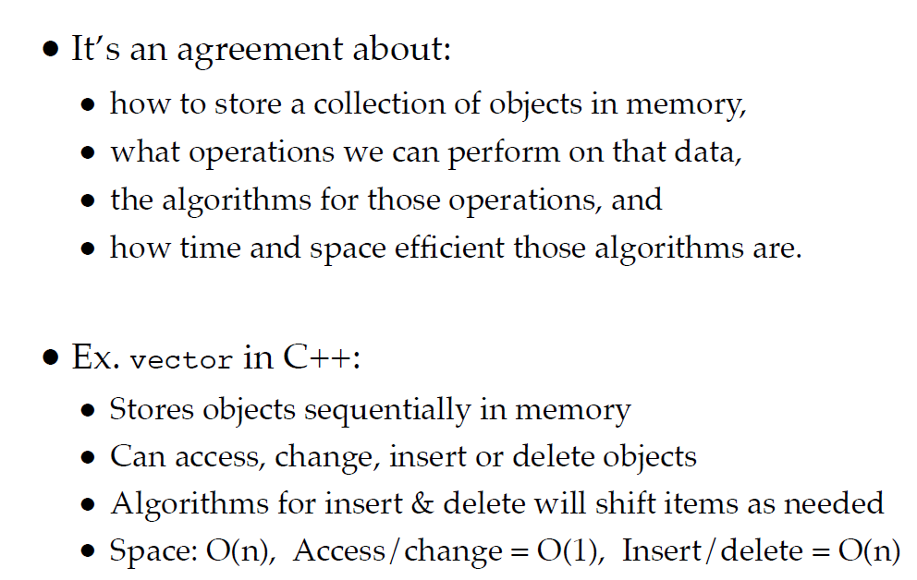
What is Data Structure?

Slide 3
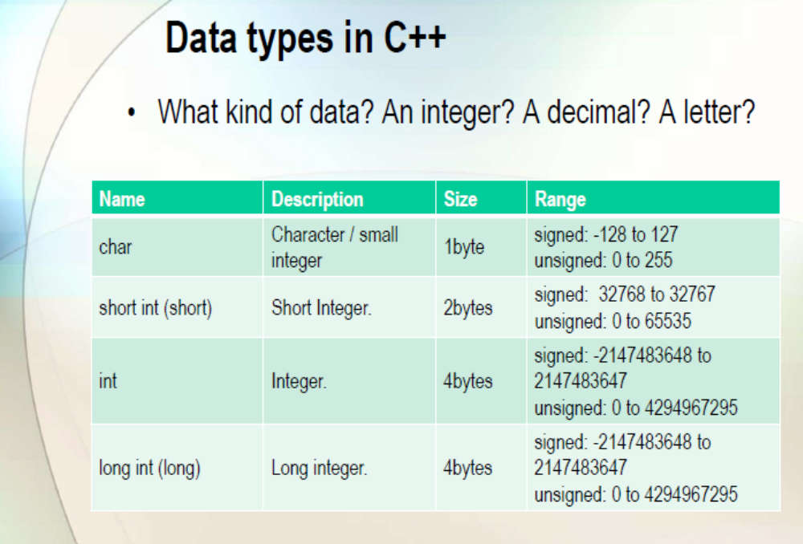

Slide 4
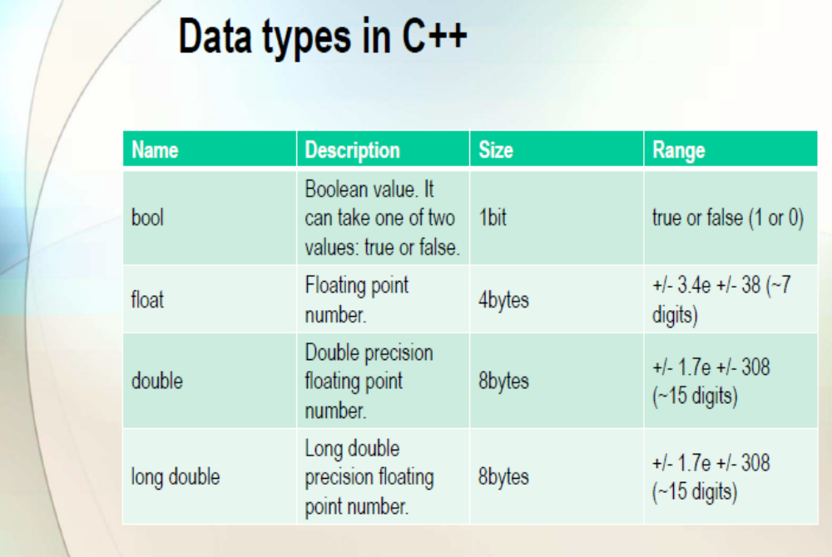

Slide 5
The first Data Structure
An Array!
  The simplest form of an Array is a one dimensional array that may be defined as a finite ordered set of homogenous elements
For Example
  int a[100];
a
1
4
3
0
1
2
. . . . .
99

Slide 6
Word about Arrays!
Arrays are data structures
  Finite
  Contiguous
  Fast
  Direct Access
  All elements of same data type
    (Can be based upon primitive or ADT)
  Insertion / Deletion ??? HOW?? ☹

Slide 7
Array - Memory Layout
The definition:
  int tests[5];
allocates the following memory:
first element | second element | third element | fourth element | fifth element
1-<number>

Slide 8
Array Terminology
In the definition int tests[5];
int is the data type of the array elements
tests is the name of the array
5, in [5], is the size declaratory. It shows the number of elements in the array.
The size of an array is (number of elements) * (size of each element)
1-<number>

Slide 9
Array Terminology
The size of an array is:
  the total number of bytes allocated for it
  (number of elements) * (number of bytes for each element)
Examples:
  int tests[5] is an array of 20 bytes, assuming 4 bytes for an int
  long double measures[10]is an array of 80 bytes, assuming 8 bytes for a long double
1-<number>

Slide 10
One Dimensional Array
Lower
Bound [0]
range = upper - lower+1
Neither the upper bound nor the lower bound can be changed and as well as the range can be changed during the program execution.
Range
Upper
Bound

Slide 11
Arrays
How to Input arrays
How to process arrays
How to insert an item in an array
How to delete an item from an array
How to pass an array

Slide 12
Accessing Array Elements
Each element in an array is assigned a unique subscript (index).
Subscripts start at 0
subscripts:
0 | 1 | 2 | 3 | 4
1-<number>

Slide 13
Accessing Array Elements
The last element’s subscript is n-1 where n is the number of elements in the array.
subscripts:
0 | 1 | 2 | 3 | 4
1-<number>

Slide 14
Basic Operations
Extraction
  A function that accepts an array “a” and an index “i”, and returns an element of the array.
  Example
    a[i]
    cout << a[i]; //it will print the content of ith location of array a.
Storing (assigning a value in to array)
  It accepts array “a” an index “i” and an element x.
  Example
  a[i]=x

Slide 15
Memory view of an array
int a[5]
2 | 3 | 4 | 7 | 8
a[0]
a[1]
a[2]
a[3]
a[4]
2
5
4
7
8
0x4
0x8
0xC
0x10
0x14
//Help me give output of this program
void main(void)
{
int a[5] = { 2,3,4,7,8 };
cout << a[3] << endl;
cout << a <<endl;
cout << *(a+1) <<endl;
cout << *a+1 <<endl;
}

Slide 16
*a +1 without brackets leads to adding 1 to contents (value) of a[0]
Out Put
7
Ox4
5
3

Slide 17
Accessing Array Elements
Array elements can be used as regular variables:
  tests[0] = 79;
  cout << tests[0];//to print
  cin >> tests[1]; //to read or scanf
  tests[4] = tests[0] + tests[1];
Arrays must be accessed via individual elements:
  cout << tests; // not legal

Slide 18
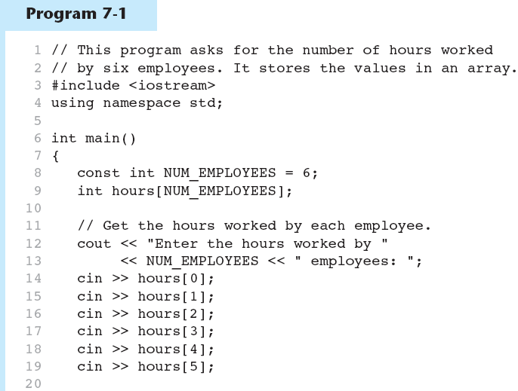
For Lab Class
(Program Continues)
1-<number>

Slide 19
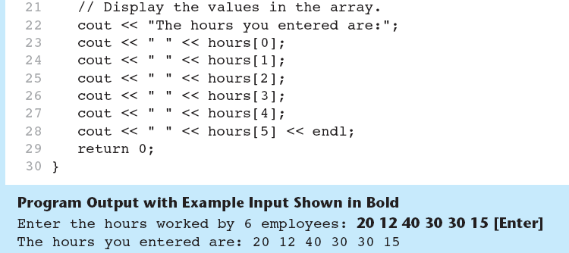
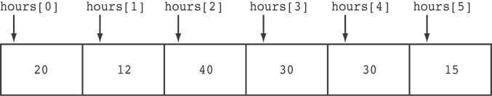
For Lab Class
Here are the contents of the hours array, with the values entered by the user in the example output:
1-<number>

Slide 20
Accessing Array Contents
Can access element with a constant or literal subscript:
  cout << tests[3] << endl;
Can use integer expression as subscript:
  int i = 5;
  cout << tests[i] << endl;
1-<number>

Slide 21
Using a Loop to Step Through (traversing) an Array
Example – The following code defines an array, numbers, and assigns 99 to each element and print:
const int ARRAY_SIZE = 5;
int numbers[ARRAY_SIZE];
for (int index = 0; index < ARRAY_SIZE; index++)
{
numbers[index] = 99;
cout << numbers[index]<< endl;
}
1-<number>

Slide 22
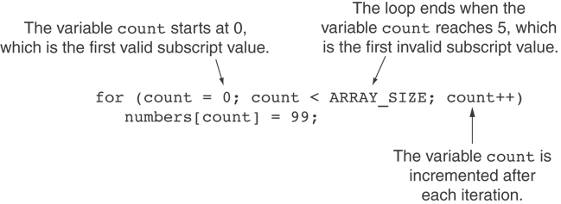
A Closer Look At the Loop
1-<number>

Slide 23
No Bounds Checking in C++
When you use a value as an array subscript, C++ does not check it to make sure it is a valid subscript.
In other words, you can use subscripts that are beyond the bounds of the array.
1-<number>

Slide 24
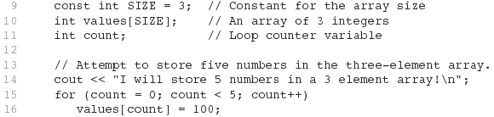
Code From Program 7-5
For Lab Class
The following code defines a three-element array, and then writes five values to it!
1-<number>

Slide 25
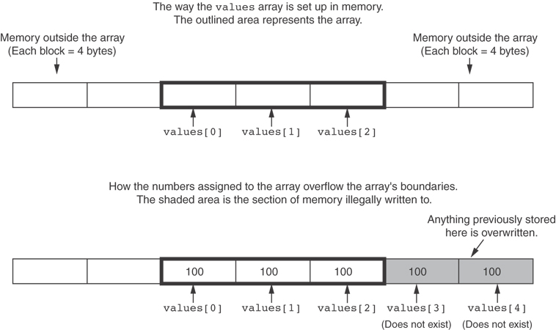
What the Code Does
1-<number>

Slide 26
Array Initialization
Arrays can be initialized with an initialization list:
const int SIZE = 5;
int tests[SIZE] = {79,82,91,77,84};
The values are stored in the array in the order in which they appear in the list.
The initialization list cannot exceed the array size.
1-<number>

Slide 27
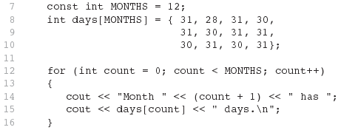
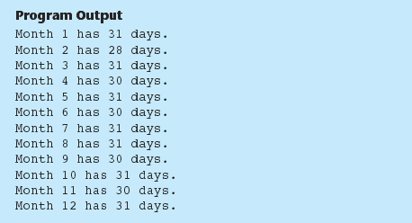
Code From Program 7-6
Lab Class
1-<number>

Slide 28
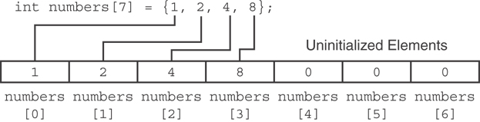
Partial Array Initialization
If array is initialized with fewer initial values than the size declarator, the remaining elements will be set to 0:
1-<number>

Slide 29
Implicit Array Sizing
Can determine array size by the size of the initialization list:
  int quizzes[]={12,17,15,11};
Must use either array size declarator or initialization list at array definition
12 | 17 | 15 | 11
1-<number>

Slide 30
Initializing With a String
Character array can be initialized by enclosing string in " ":
  const int SIZE = 6;
  char fName[SIZE] = "Henry";
Must leave room for \0 at end of array
If initializing character-by-character, must add in \0 explicitly:
  char fName[SIZE] =
  { 'H', 'e', 'n', 'r', 'y', '\0'};
1-<number>

Slide 31
Character arrays (Strings)
Review
A[0]
A[1]
A[2]
A[3]
A[4]
A
L
I
\0
Garbage
A | L | I | \0

Slide 32
Processing Array Contents
Array elements can be treated as ordinary variables of the same type as the array
When using ++, -- operators, don’t confuse the element with the subscript:
  tests[i]++; // add 1 to tests[i]
  tests[i++]; // increment i, no
  // effect on tests
1-<number>

Slide 33
Array Assignment
To copy one array to another,
Don’t try to assign one array to the other:
  newTests = tests; // Won't work
Instead, assign element-by-element:
  for (i = 0; i < ARRAY_SIZE; i++)
  newTests[i] = tests[i];
1-<number>

Slide 34
Printing the Contents of an Array
You can display the contents of a character array by sending its name to cout:
char fName[] = "Henry";
  cout << fName << endl;
  But, this ONLY works with character arrays!
1-<number>

Slide 35
Printing the Contents of an integer Array
For other types of arrays, you must print element-by-element:
  for (int i = 0; i < ARRAY_SIZE; i++)
  cout << tests[i] << endl;
1-<number>

Slide 36
Array
2 | 3 | 7 | 8
How to add 4
2 | 3 | 4 | 7 | 8
How to add 1 in the array?
Not possible

Slide 37
Insertion a new item to array
An array a with n elements. Insert an element in k location.
i= n-1
(check for full array)
Repeat while i is greater or equal to k
a[i+1] = a[i] //right shift
and i = i- 1
A[k] = new item and n = n+1

Slide 38
Summing and Averaging Array Elements
Use a simple loop to add together array elements:
  int tnum;
  double average, sum = 0;
  for(tnum = 0; tnum < SIZE; tnum++)
  sum += tests[tnum];
Once summed, can compute average:
  average = sum / SIZE;
1-<number>

Slide 39
Finding the Highest Value in an Array
int count;
int highest;
highest = numbers[0];
for (count = 1; count < SIZE; count++)
{
if (numbers[count] > highest)
highest = numbers[count];
}
When this code is finished, the highest variable will contains the highest value in the numbers array.
1-<number>

Slide 40
Finding the Lowest Value in an Array
int count;
int lowest;
lowest = numbers[0];
for (count = 1; count < SIZE; count++)
{
if (numbers[count] < lowest)
lowest = numbers[count];
}
When this code is finished, the lowest variable will contains the lowest value in the numbers array.
1-<number>

Slide 41
Partially-Filled Arrays
If it is unknown how much data an array will be holding:
  Make the array large enough to hold the largest expected number of elements.
  Use a counter variable to keep track of the number of items stored in the array.
1-<number>

Slide 42
Comparing Arrays
To compare two arrays, you must compare element-by-element:
const int SIZE = 5;
int firstArray[SIZE] = { 5, 10, 15, 20, 25 };
int secondArray[SIZE] = { 5, 10, 15, 20, 25 };
bool arraysEqual = true; // Flag variable
int count = 0; // Loop counter variable
// Compare the two arrays.
while (arraysEqual && count < SIZE)
{
if (firstArray[count] != secondArray[count])
arraysEqual = false;
count++;
}
if (arraysEqual)
cout << "The arrays are equal.\n";
else
cout << "The arrays are not equal.\n";
1-<number>

Slide 43
Using Parallel Arrays
Parallel arrays: two or more arrays that contain related data
A common subscript is used to relate arrays: elements at same subscript are related
Arrays may be of different types
1-<number>

Slide 44
Parallel Array Example
const int SIZE = 5; // Array size
int id[SIZE]; // student ID
double average[SIZE]; // course average
char grade[SIZE]; // course grade
...
for(int i = 0; i < SIZE; i++)
{
cout << "Student ID: " << id[i]
<< " average: " << average[i]
<< " grade: " << grade[i]
<< endl;
}
1-<number>

Slide 45
Two-Dimensional Arrays
Can define one array for multiple sets of data
Like a matrix or a table in a spreadsheet
Use two size declarations in definition:
  const int ROWS = 4, COLS = 3;
  int exams[ROWS][COLS];
First declarator is number of rows; second is number of columns
1-<number>

Slide 46
Two-Dimensional Array Representation
const int ROWS = 4, COLS = 3; int exams[ROWS][COLS];
Use two subscripts to access element:
  exams[2][2] = 86;
columns
exams[0][0] | exams[0][1] | exams[0][2]
exams[1][0] | exams[1][1] | exams[1][2]
exams[2][0] | exams[2][1] | exams[2][2]
exams[3][0] | exams[3][1] | exams[3][2]
r
o
w
s
1-<number>

Slide 47
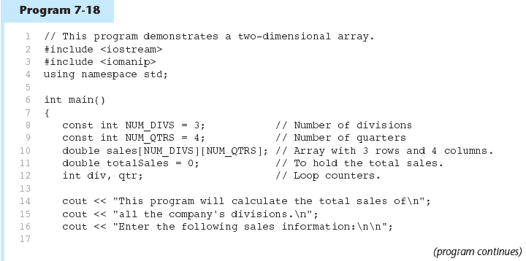
1-<number>

Slide 48
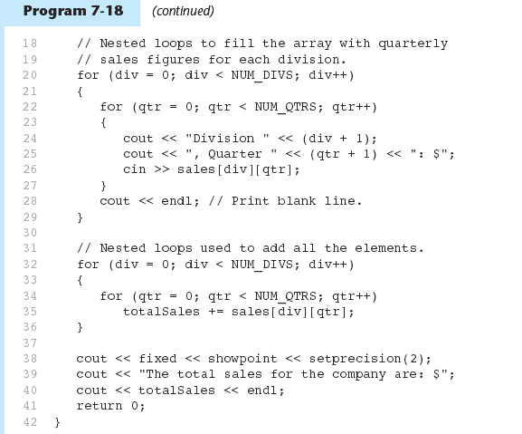
1-<number>

Slide 49
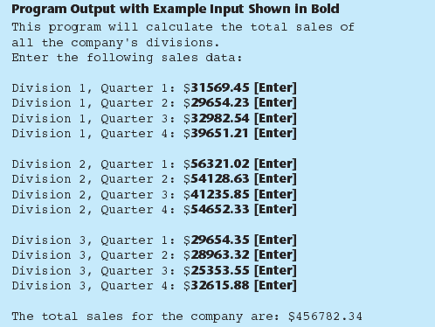
1-<number>

Slide 50
2D Array Initialization
Two-dimensional arrays are initialized row-by-row:
const int ROWS = 2, COLS = 2;
int exams[ROWS][COLS] = { {84, 78},
  {92, 97} };
Can omit inner { }, some initial values in a row – array elements without initial values will be set to 0 or NULL
84 | 78
92 | 97
1-<number>

Slide 51
Array of Strings
Use a two-dimensional array of characters as an array of strings:
const int NAMES = 3, SIZE = 10;
char students[NAMES][SIZE] =
  { "Ann", "Bill", "Cindy" };
Each row contains one string
Can use row subscript to reference the string in a particular row:
  cout << students[i];
1-<number>

Slide 52
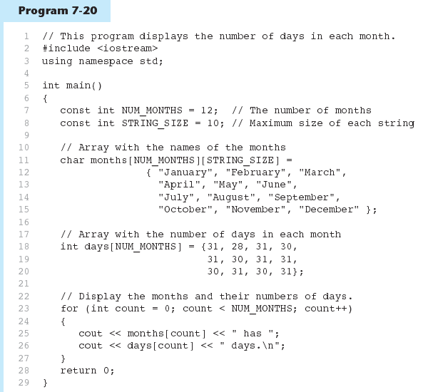
1-<number>

Slide 53
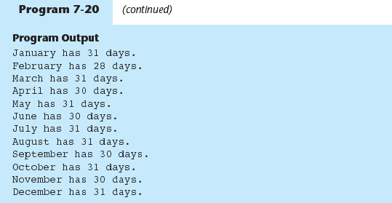
1-<number>

Slide 54
Arrays with Three or More
Dimensions
Can define arrays with any number of dimensions:
  short rectSolid[2][3][5];
  double timeGrid[3][4][3][4];
When used as parameter, specify all but 1st dimension in prototype, heading:
  void getRectSolid(short [][3][5]);
1-<number>

